Slide 1

CSE4074 · FORENSIC ANALYTICS · M.TECH RESEARCH PROPOSAL
Early Detection of Money Laundering Rings using Temporal Transaction Network Analytics and Explainable Risk Scoring
NETWORK EVOLUTION
NORMAL
EMERGING
SUSPICIOUS
B
“Detecting coordinated laundering behaviour before the suspicious network fully emerges”
A
D
E
C
Transactions → relationships → time → forensic pattern
Student Name · Register Number · Programme · Review 1 · Institution

Slide 2

01 / PROBLEM UNDERSTANDING
Why Is Money Laundering Difficult to Detect?
A single transaction may appear legitimate.
ILLUSTRATIVE FUND FLOW
Laundering often uses multiple intermediary accounts and indirect paths.
A
B
C
D
Suspicious behaviour emerges through relationships, timing, and repetition.
Individually: normal-looking transfers
A coordinated ring may become obvious only after several transactions occur.
Collectively: rapid, repeated, interconnected movement
TRANSACTION + RELATIONSHIP + TIME = FORENSIC PATTERN
Takeaway: Money laundering is not only a transaction-level problem; it is a relationship-and-time problem.

Slide 3

02 / SPECIFIC PROBLEM + MOTIVATION
Shift From Final Detection to Early Warning
Current state: Existing AML research can detect suspicious transactions, networks, groups, temporal patterns, and evidence.
FORENSIC VALUE
Earlier identification gives investigators more time to examine the network.
Limitation: Detection may occur only after sufficient suspicious structure has emerged.
Research question: Can the evolving formation of a laundering ring be detected earlier?
SCALE
Millions of transactions make complete manual examination impractical.
Individual
transactions
Emerging
relationships
Suspicious
structure
Laundering
ring
EVOLUTION
→
→
→
Suspicious behaviour may emerge gradually rather than in one transaction.
EARLY-WARNING OPPORTUNITY: BEFORE THE FINAL STAGE
EXPLAINABILITY
Investigators need to know why a network was flagged.
Shift the focus from detecting a suspicious ring to detecting its evolution.

Slide 4

03 / RESEARCH DESIGN
Research Objectives and Questions
FIVE OBJECTIVES
FIVE RESEARCH QUESTIONS
O1
Model financial transactions as a time-evolving network.
RQ1
Can temporal transaction-network behaviour identify emerging laundering patterns?
O2
Extract temporal, behavioural, and network characteristics.
RQ2
Can a ring be detected before its complete suspicious structure becomes visible?
O3
Identify laundering-related fund-flow patterns.
RQ3
Does temporal analysis improve early detection over static graph analysis?
O4
Detect emerging laundering rings as early as possible.
RQ4
Can each warning be explained using transaction and network evidence?
O5
Generate explainable risk scores with supporting forensic evidence.
RQ5
How much detection lead time is achieved while controlling false warnings?
CENTRAL RESEARCH QUESTION
HOW EARLY CAN WE KNOW?

Slide 5

04 / LITERATURE REVIEW · EVIDENCE MATRIX
Literature Review — Directly Relevant Research
Seven studies establish the building blocks; the highlighted gap column identifies the formation-stage opportunity.
No.
Full Paper Title
Publisher / Year
Dataset
Method
Contribution
Relevant Gap
[1]
Anomaly Detection in Graphs of Bank Transactions for Anti Money Laundering Applications
IEEE Access, 2022
Bank transaction graph; synthetic anomalies
Reduced-egonet; random-walk/ring features; Isolation Forest
Graph anomaly and circular-flow detection
Exact transaction time not explicitly modelled.
[2]
Detecting Hawala Network for Money Laundering by Graph Mining
Elsevier, 2024
Berka; augmented transactions
Blackhole; hidden-link metrics; PageRank; graph ranking
Hidden Hawala structure detection and ranking
Hawala-specific; not general formation-stage warning.
[3]
TMAS: A Transaction Misbehavior Analysis Scheme for Blockchain
Elsevier, 2024
Large-scale Bitcoin transactions
Indicators; linkage; circular/indirect patterns
Large-scale suspicious transaction analysis
Ring formation not explicitly early warning.
[4]
Complex Networks-Based Anomaly Detection for Financial Transactions in Anti-Money Laundering
Elsevier, 2025
Anonymized investigation data
Communities; density; cycles; LUNAR; temporal analysis
Forensic network/anomaly analysis
Lead time for emerging rings not central.
[5]
Multi-View Graph-Based Hierarchical Representation Learning for Money Laundering Group Detection
IEEE TIFS, 2025
GDSC; AMLSim
Multi-view; heterogeneous graphs; hypergraphs
Organized laundering-group detection
Groups identified; formation not explicitly tracked.
[6]
GraphNet-Launder: A Graph-Based Deep Intelligence Framework for Real-Time Money Laundering Detection in Financial Networks
IEEE, 2025
AMLSim; Elliptic
Dynamic graphs; Temporal GNN/TGAT; attention
Temporal ring detection with interpretable attention
Proposed focus: early-stage detection and lead-time evaluation.
[7]
Quantum-Enhanced AML: Hybrid Quantum–Classical Graph Learning With Entity Resolution and Evidence Subgraph Discovery for Transaction Screening
IEEE Access, 2026
Elliptic2
Temporal learning; entity resolution; risk scoring; evidence
Time-aware screening with evidence output
Formation-stage detection and lead-time evaluation remain open.
Literature trajectory: transaction graphs → network AML → group detection → temporal learning → explainable AML.

Slide 6

05 / LITERATURE SYNTHESIS
What Has the Literature Already Solved?
The building blocks are established; the opportunity is to connect them around evolving-ring early warning.
FOUR RESEARCH-GAP TRANSITIONS
ESTABLISHED AML CAPABILITIES
G1 · Detection → Early detection
Graph-based AML
✓
“Is it suspicious?” → “Is it becoming suspicious?”
Circular-flow detection
✓
G2 · Structure → Formation
Laundering-group detection
✓
Detect an observable ring → Track how the ring forms.
Temporal graph learning
✓
G3 · Pattern → Trajectory
Ring detection
✓
Individual motif → Sequence of evolving motifs.
Explainable AML
✓
G4 · Accuracy → Lead time
Evidence generation
✓
F1 / AUC → F1 / AUC + How early?
Key message: The research gap lies in the evolution toward a suspicious ring, not merely the final ring itself.
OPEN OPPORTUNITY
Formation-stage early warning
⚠
Detection lead-time evaluation
⚠
Evolving pattern trajectory
⚠

Slide 7

06 / RESEARCH CONTRIBUTION
Proposed Research Novelty
The contribution is not a new graph, GNN, or risk score in isolation. It is the explicit framing of evolving laundering-ring behaviour as a formation-stage early-warning problem.
01 / EARLY IDENTIFICATION
02 / TEMPORAL EVOLUTION
03 / PATTERN TRAJECTORY
04 / DETECTION LEAD TIME
05 / EXPLAINABLE RISK
87/100
◉ → ◉ → ◉
t₁ → t₂ → t₃
↗ → ↘ → ↻
D−3
Preserve evidence
Detect during formation
Track change over time
Analyse sequences
Measure how early
Connect each score to time, accounts, transactions, paths, and risk factors.
Fan-in → layering → fan-out → emerging cycle becomes a trajectory.
Evaluate warning time before the ring becomes fully observable.
Identify laundering-ring behaviour before the suspicious structure is complete.
Compare how suspicious network behaviour changes across successive windows.
ACADEMIC POSITIONINGExisting research establishes the building blocks; this work focuses specifically on formation-stage early warning and explicit lead-time evaluation with explainable forensic evidence.

Slide 8
07 / PROPOSED SOLUTION
Proposed Solution — From Transactions to Forensic Warning
Continuously evaluate whether transaction evolution is becoming increasingly consistent with a laundering-ring pattern.
01
02
03
04
05
06
07
08
⇄
◉↔◉
ƒ(x)
↗↘
t₁→t₂
87
≡
✓
RAW
TRANSACTIONS
→
TEMPORAL
NETWORK
→
FEATURES
→
FUND-FLOW
PATTERNS
→
PATTERN
EVOLUTION
→
EMERGING
RING RISK
→
EVIDENCE
→
INVESTIGATOR
PRIORITY
velocity · gaps
connectivity
paths · accounts
transactions
sender · receiver
amount · time
accounts as nodes
flows as edges
fan-in · layering
fan-out · cycles
appearance
combination
early warning
score 0–100
warning → action
OBSERVE → TRACK → WARN → EXPLAIN

Slide 9

08 / METHODOLOGY
Proposed Methodology
Five stages convert raw transaction activity into an explainable, investigation-ready early warning.
DATA PREPARATIONClean → Validate → Order
01
Clean, validate, de-duplicate, and chronologically order the transaction stream.
02
TEMPORAL GRAPHAccounts + transactions
Account = node · transaction = directed edge · amount = weight · timestamp = evolution.
FEATURE ENGINEERINGBehavioural + network signals
03
Velocity, frequency, time gaps, amount behaviour, connectivity, and account activity.
04
PATTERN ANALYSISFund-flow motifs
Fan-in, fan-out, layering, split-merge, cycles, and combinations over time.
EARLY-WARNING OUTPUTRisk + evidence + priority
05
Generate an explainable risk score with supporting forensic evidence.
DATA COLLECTION → PREPROCESSING → TEMPORAL / NETWORK ANALYSIS → ANOMALY DETECTION → FORENSIC PRIORITY

Slide 10
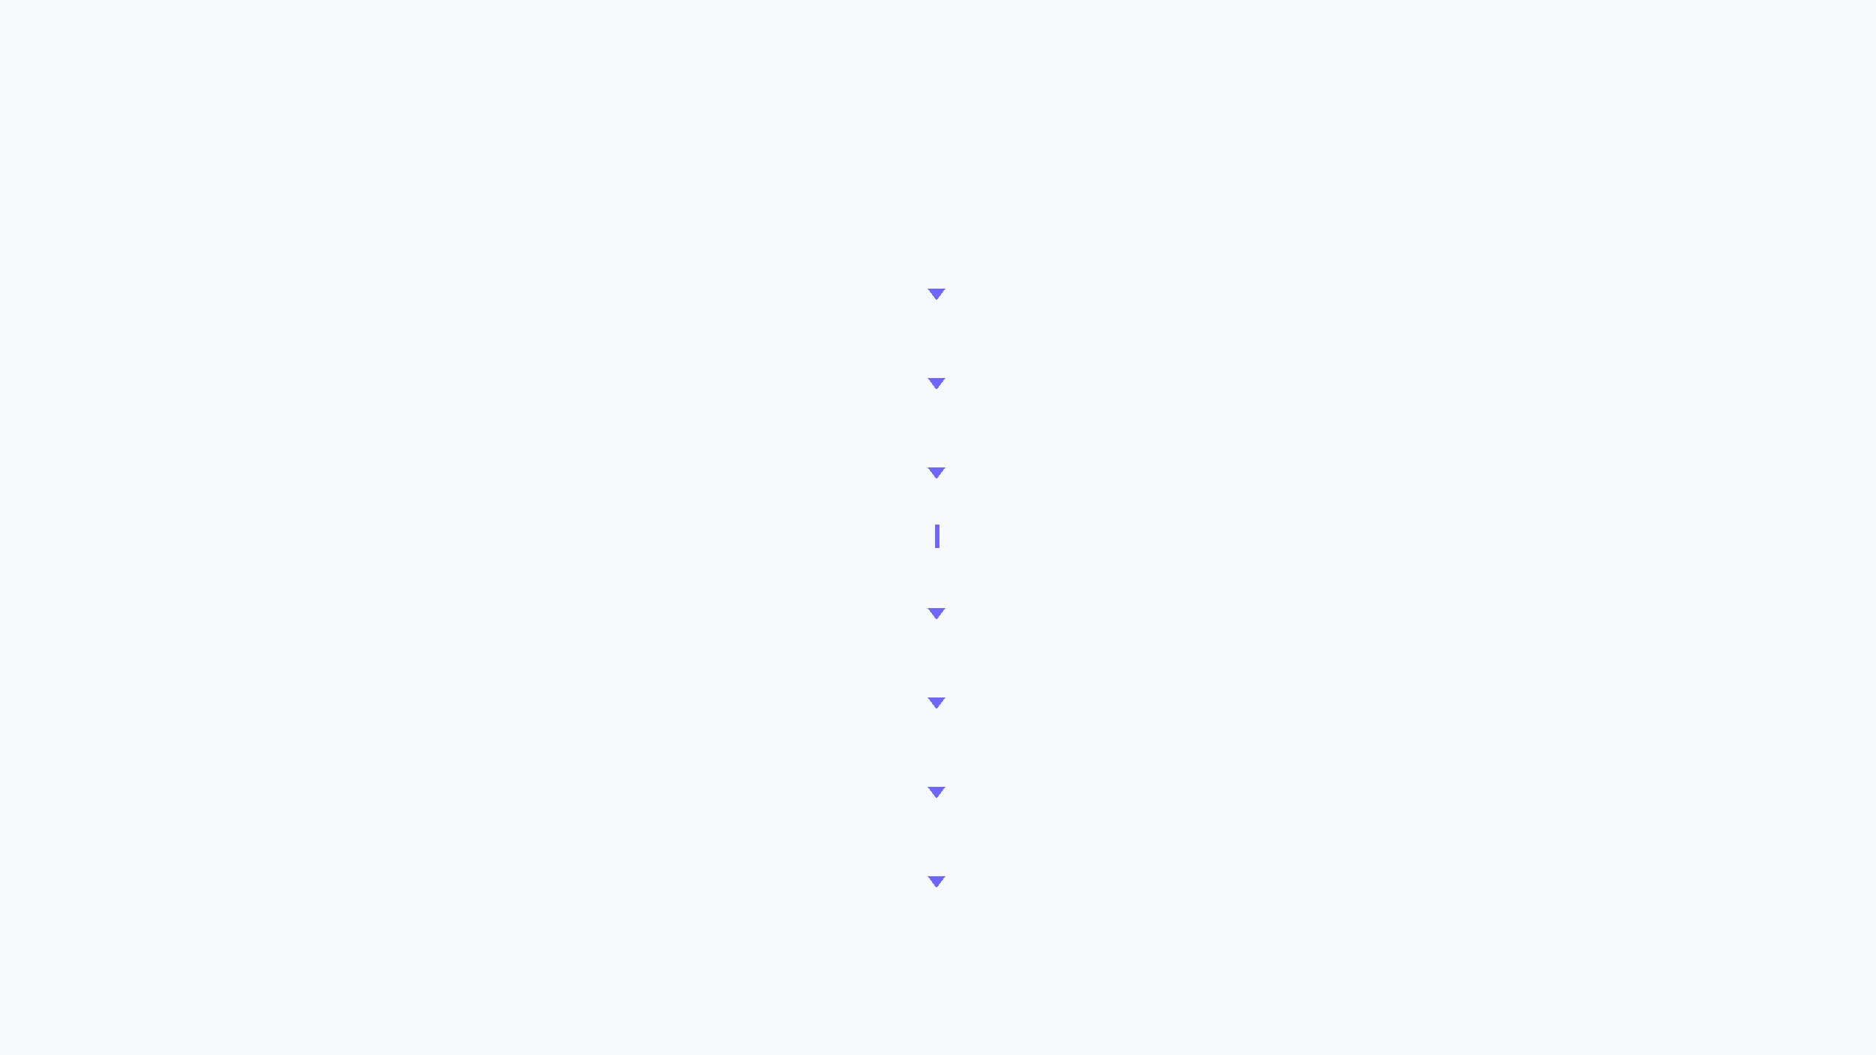
09 / SYSTEM ARCHITECTURE
Proposed Forensic Early-Warning Architecture
DATA → ANALYSIS → DETECTION → EVIDENCE → INVESTIGATION
TRANSACTION STREAM
Sender | Receiver | Amount | Timestamp
DATA PREPROCESSING
Clean | Validate | De-duplicate | Chronologically order
TEMPORAL TRANSACTION NETWORK
Nodes = Accounts · Edges = Transactions · Weight = Amount
BEHAVIOURAL FEATURES
NETWORK FEATURES
velocity · frequency · gaps
connectivity · density · paths
TEMPORAL FUND-FLOW PATTERNS
Fan-in | Fan-out | Layering | Split-Merge | Cycle
PATTERN EVOLUTION
Appearance → Combination → Emerging Ring
EARLY RING RISK SCORE · 0–100
Formation-stage warning before completion
EXPLAINABLE EVIDENCE
Time | Accounts | Paths | Transactions | Risk Factors
FORENSIC INVESTIGATOR
Warning → Evidence → Investigation Priority
Design principle: Every warning preserves temporal and network evidence for forensic review.
OBSERVE · TRACK · WARN · EXPLAIN

Slide 11

10 / DATASET + EXPERIMENTAL DESIGN
Dataset Strategy and Experimental Evaluation
Compare controlled development, external validation, established baselines, and the primary forensic measure: detection lead time.
DATASET STRATEGY
COMPARISON DESIGN
PRIMARY METRIC: DETECTION LEAD TIME
AMLSim PRIMARY
B1
Static graph anomaly detection
SYSTEM WARNING
RING OBSERVABLE
AML-specific, public/reproducible, timestamped, graph-compatible, with known laundering scenarios. Used for development and early-warning experiments.
B2
Transaction / behavioural machine learning
DAY 7
DAY 10
B3
Existing temporal graph approach
Elliptic2 SECONDARY
3 DAYS EARLIER
External validation of suspicious graph/subgraph detection. Not assumed identical to AMLSim.
P
Proposed early-warning temporal network analytics
DETECTION QUALITY
Evaluation question: How much earlier can suspicious evolution be identified while controlling false warnings?
Dataset provenance is distinct from Kaggle access/distribution.
Precision · Recall · F1 · PR-AUC · ROC-AUC
FORENSIC UTILITY
Ring detection rate · false-warning rate · top-k precision
EARLY-WARNING VALIDITY
Detection-before-completion rate
CLASSIFY LESS · EXPLAIN MORE · WARN EARLIER

Slide 12

11 / EXPECTED IMPACT · CLOSING SYNTHESIS
Expected Outcomes, Conclusion & References
From detecting suspicious transactions to recognising the evolving trajectory of a laundering ring early enough to support investigation.
EXPECTED OUTCOMES
MOCK INVESTIGATOR OUTPUT
01
Time-evolving transaction-network representation.
EMERGING RING #27
02
Identification of suspicious fund-flow patterns.
RISK SCORE: 87 / 100 · HIGH — FORMATION
03
Early identification of evolving laundering rings.
WHY FLAGGED?
04
Quantifiable detection lead time.
Rapid transfers
Repeated intermediary
05
Explainable forensic risk scoring.
Layering behaviour
Emerging circular flow
Increasing connectivity
Temporal escalation
CONCLUSION
Prioritize Network #27 for investigation.
Money laundering is a dynamic and coordinated network problem.
Existing research provides graph, group, temporal, and explainable AML capabilities.
A risk score indicates investigative priority; it does not establish criminal guilt.
This research focuses on early identification of evolving laundering rings.
Success is evaluated using detection quality and detection lead time.
FINAL RESEARCH CONTRIBUTIONA forensic early-warning framework for identifying evolving money-laundering rings and explaining the temporal/network evidence behind each warning.
[1] Anomaly Detection in Graphs of Bank Transactions for Anti Money Laundering Applications — IEEE Access, 2022.
[2] Detecting Hawala Network for Money Laundering by Graph Mining — Journal of Finance and Data Science, 2024.
[3] TMAS: A Transaction Misbehavior Analysis Scheme for Blockchain — Blockchain: Research and Applications, 2024.
[4] Complex Networks-Based Anomaly Detection for Financial Transactions in Anti-Money Laundering — Forensic Science International: Digital Investigation, 2025.
[5] Multi-View Graph-Based Hierarchical Representation Learning for Money Laundering Group Detection — IEEE TIFS, 2025.
[6] GraphNet-Launder: A Graph-Based Deep Intelligence Framework for Real-Time Money Laundering Detection in Financial Networks — IEEE, 2025.
[7] Quantum-Enhanced AML: Hybrid Quantum–Classical Graph Learning With Entity Resolution and Evidence Subgraph Discovery for Transaction Screening — IEEE Access, 2026.

